Slide 1
(Guest)
Index
/
Signup page
Guest
Signup
/register
Logout page
Guest
Login page
Guest
New Saved user
Guest
New Saved User
Logout
/newSavedUser
/logout
Login
Page not found
404
/login
All Stories page
Guest
All Stories page
Signed in
Any run time error
500
Write story
Signed in
New Story
AllStories
/newstory
/allstories
Specific story page
Signed in
Specific story page
Guest
Story
Slug: It refers to shortenedURL friendly name of a story
Its informal way of reference anyway. Check here.
/stories/slugStory
Tutorial website: http://leave-the-marks.herokuapp.com/

Slide 2
Phase 1
Phase 2
Phase 3
Phase 4
Phase 5
Story Mgmt
Story Mgmt
Others*
User Mgmt
User Mgmt
User Mgmt
User Mgmt
Templates
Templates
Templates
Templates
Templates
MongoDB
(local)
MongoDB
(local)
MongoDB
(Cloud)
Complete user
Management
Excluding stories
Complete
Management
Including stories
Error Mgmt (404, 500,Chalk)
Add comments option (if possible)

Slide 3
Phase 1
Pages | Description
Index.html | Home page. User many click diff options
Login.html
Signup.html
NewSavedUser.html | Welcoming user after Sign up. Asks hims to login
Newstory.html | Page to create new story (summernote)
allStories.html | Page to show all stories
slugStory.html | Page showing specific user’s story
Logout.html | Page telling user has logged out
Templates
Dependencies:
Express
EJS
Note:
More routes will evolve as we go on to next phases (eg, what if user credentials wrong)

Slide 4

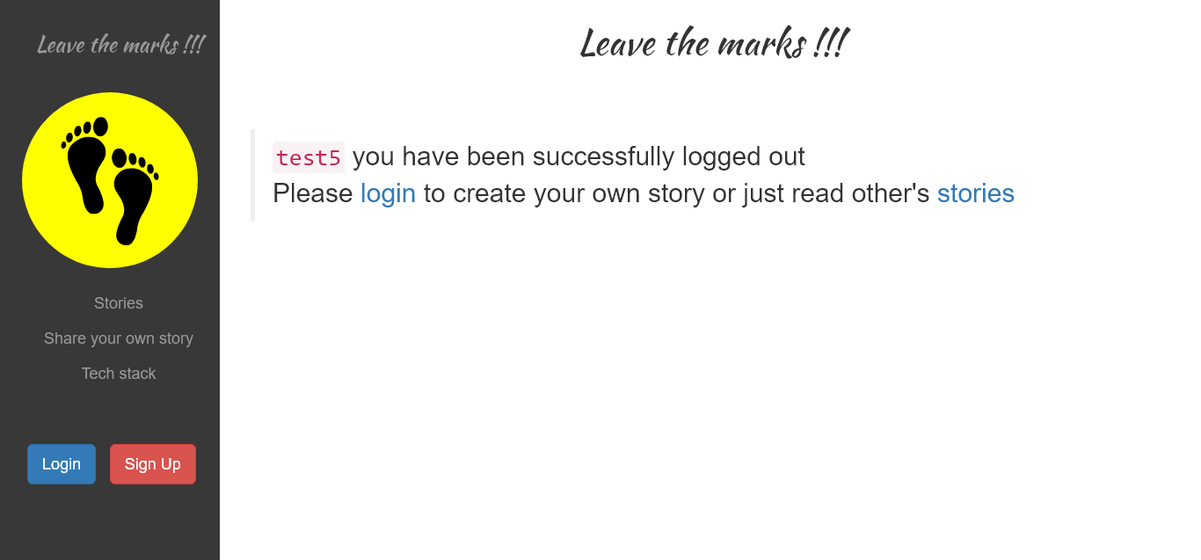
Phase 1
Index.html
Reference snippet: https://bootsnipp.com/snippets/BDWlD
login.html / register.html
Reference snippet: https://bootsnipp.com/snippets/featured/sign-in-panel
logout.html
Logout is almost similar to newUser. This page is shown once
User presses Logout
Note the sidebar changes now to showing login and signup options
In phase 1, log out shall be directly accessed with url as we have not yet
Started user session management

Slide 5
Phase 1
User creation is in 3 stages. Note that, its 2 pages.
Also note “GET” when you are rendering html next, “POST” if underground Pageless Operation (authentication, DB, etc)
register.html
Pageless
newSavedUser.html
Login.html
User Signs up
Action: Clicks the Signup
Button after entering
Credentials
Check if
User already
Exists
If no, register and send to
Welcomepage
Asking him to
login
Congragulate the user as he has
Been successfully
Registered.
Ask him to login
User logs in
Action: Clicks the login
Button after entering
Credentials
/newUser
/newSavedUser
/login
POST
GET
GET
Dummification
For Phase 1
success

Slide 6
Phase 1
Story creation is in 5 stages. Note that, its 3 pages, but 4 routers.
Also note “GET” when you are rendering html next, “POST” if underground Pageless Operation (authentication, DB, etc)
Login.html
Pageless
newStory.html
Pageless
allStories.html
slugStory.html
Server authenticates
Check if user & pw
Matches in DB,
If success, proceed to newstory
Else go back to login
Try to save
The story
In the DB
If success, go
To all Stories
Page
Else throw error 500
User logs in
Action: Clicks the login
Button after entering
Credentials
User creates the story
Title
Content, that’s it.
User enters submit
Show title and link
For all user stories
Here.
Show the chosen
Story
Fully
here
/authenticate
/newStory
/addStory
/allStories
/slugStory
POST
GET
POST
GET
GET
Dummification
For Phase 1
success
success
Dummy Stories

Slide 7
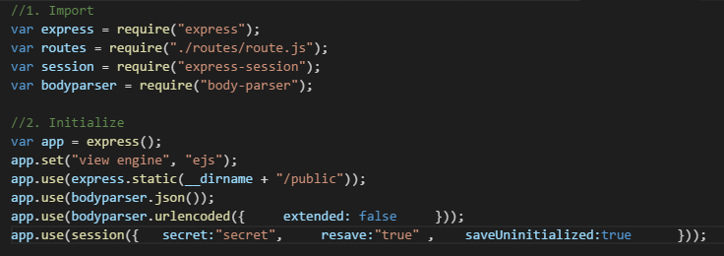
Phase 2
Temp
Session
Signup
User Mgmt
Store user data in new session
Templates
Login
Allow login if entered credentials available in current session
If not, ask them to signup
If so, take to new story
Npm install express-session –save
Npm install body-parser --save
Logout
Destroy current session and show log out page
Side bar
If logged in current session, display logout button
If not, display login and signup buttons
Other Pages
If all stories page, show even without login
If new story, check if logged in session, if not ask to login first.

Slide 8
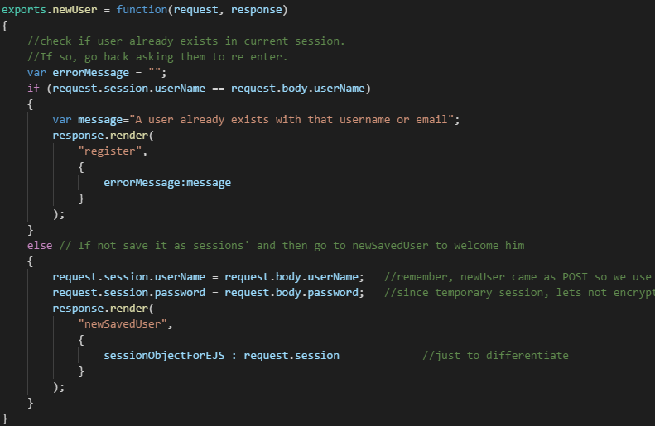
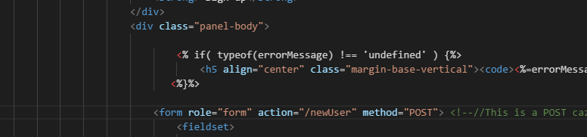
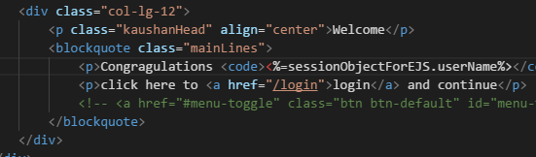
Phase 2
Temp
Session
Signup
Store user data in new session
Check if username already exists in session. If so, call “register” page again, with error message heading (sent from route)
If not existing, get the credentials from body (using body parser) and save that as session’s parameters.
Routing (decide which way to go)
Register.ejs (showing error in case user already exists)
newSavedUser.ejs (welcoming user)

Slide 9
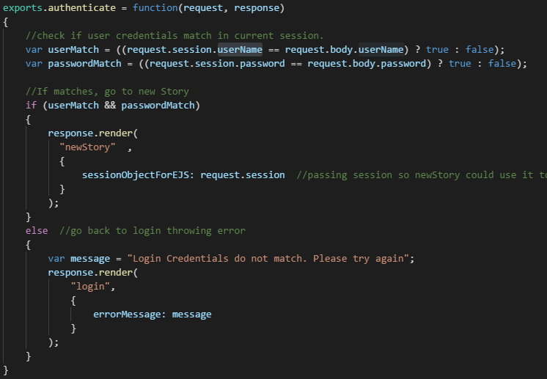
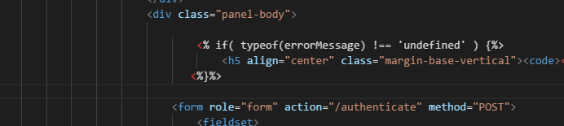
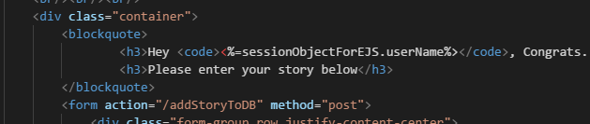
Phase 2
Temp
Session
Check if entered credentials available in current session
If not, ask them to signup
If so, take to new story
Routing (decide which way to go)
Login
login.ejs (showing error in case user not existing)
newStory.ejs (welcoming user)

Slide 10
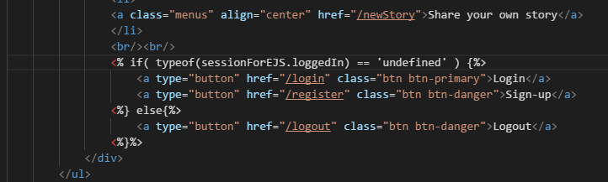
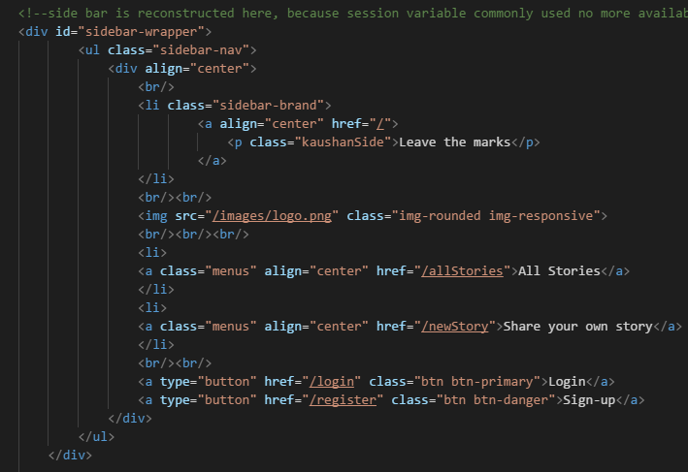
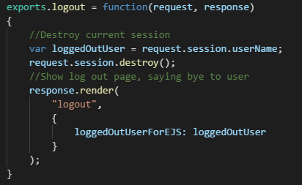
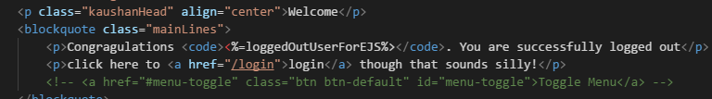
Phase 2
Sidebar evaluating status..
Temp
Session
Logout
Destroy current session and show log out page
Say bye to user
Side bar
If logged in current session, display logout button
If not, display login and signup buttons
So in routing, for all EJS that uses sidebar, session info to be passed on
Allstories, index, logout, newUser, slugStory
Further, Because we destroy session in logout, we cant use common sidebar as
Session variable no more available when logout page is constructed
Logout.ejs having hard coded sidebar as no more session
Routing (Logout)
Logout.ejs saying bye to user

Slide 11
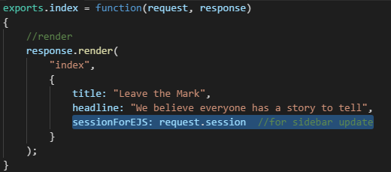
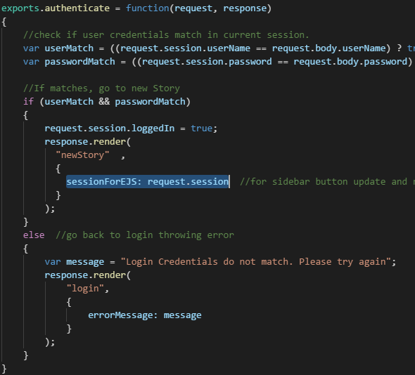
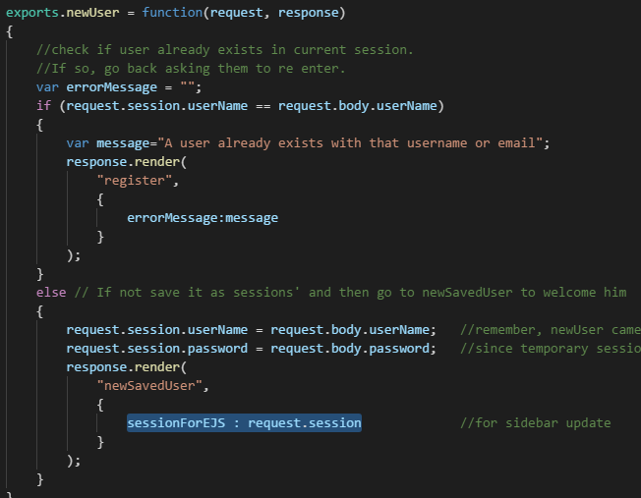
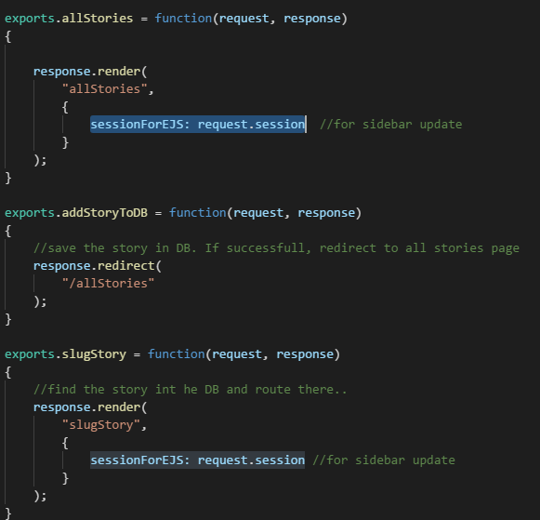
Phase 2
index
authenticate
Temp
Session
Side bar
newUser
“sessionForEJS” parameter sent
from all these routing modules..
allStories
slugStory

Slide 12
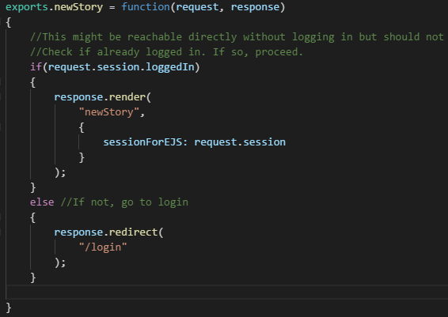
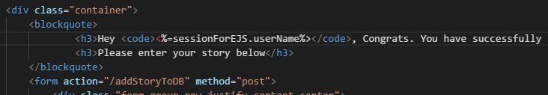
Phase 2
Temp
Session
Other Pages
If all stories page, show even without login – automatically taken care in previous steps
If new story, check if logged in session, if not ask to login first.
Routing
Address user in new story..

Slide 13
Phase 3
Mongoose
Note that, DB now comes in middle
Between session and front end, not after.
This is because, we store in DB, and
Then update that to session
We store both username, and Pw in DB
And retrieve only username to use
across session
Step 1: Bare minimum DB for signup&login
Step 2: Hashed PW
Story DB we will do in later Phase
Temp
Session
Save
Signup
User Mgmt
Templates
findOne
Login
MongoDB
(local)
Compare
Password
Complete user
Management
Excluding stories

Slide 14
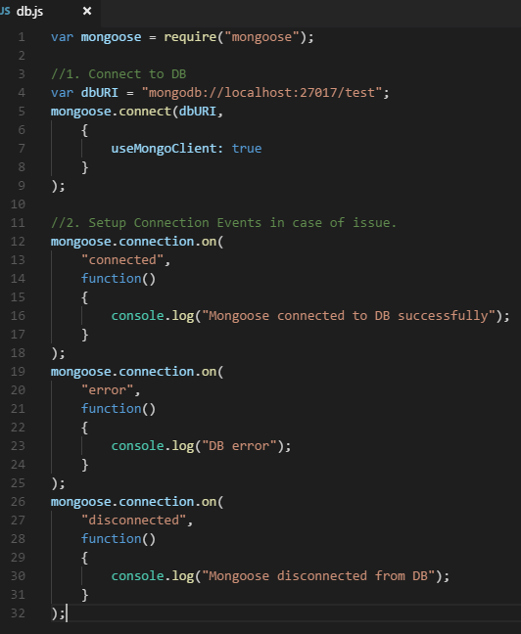

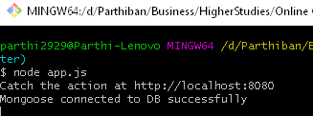
Phase 3
Db.js
First we will initialize, and keep the mongoose
Connected to the DB
Then as per need we will implement further methods
Shortly
Overview:
Create mongoose instance and connect to DB (connection.on)
Create Schema (User – as later we would need one more for Stories)
Create model and export
Use in other route modules
Just require it in app.js, will get it loaded (mongoose connected to DB)
Result:

Slide 15
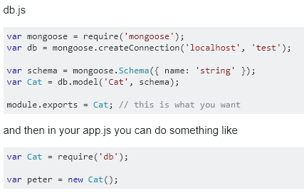
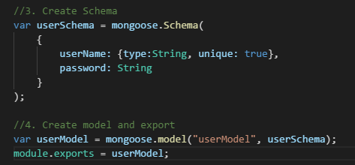
Phase 3
Reference to export model and use it elsewhere:
Overview:
Create mongoose instance and connect to DB (connection.on)
Create Schema (User – as later we would need one more for Stories)
Create model and export
Use in other route modules
We shall store only following in DB
username (unique)
Password (not yet hashed) (need not be unique)

Slide 16
Phase 3
Overview:
Create mongoose instance and connect to DB (connection.on)
Create Schema (User – as later we would need one more for Stories)
Create model and export
Use it in the route module
Function | Route phase | Current Operation | Needed Operation
Signup | /newUser | Storing in session Check if user already in session’s username. If so, user already exists error, Render /register with errorMessage If not, store it as session’s user name. Render /newSavedUser (pass on session details) | Store in DB Create new mongoose model with given credentials Save the model (writes to DB) If error returned, “user already exists”, Render /register with errorMessage If no error, store returned username as session’s user name. Render /newSavedUser (pass on session details)
Login | /authenticate | Logging in session Check if user credential’s match with current session If so, render /newStory (pass on session details) Session.loggedIn = true If not, render /login with errorMessage | Logging using DB Check if username is in the DB If null returned, render /login with errorMessage (user does not exist). Exit function. If not null, check if password matches in DB. If so, render /newStory (pass on session details) Session.loggedIn = true If not, render /login with errorMessage (pw does not match) (Not a good practise to explicitly say which is not matching, but this is for dev purpose)

Slide 17
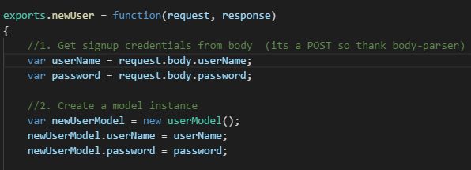
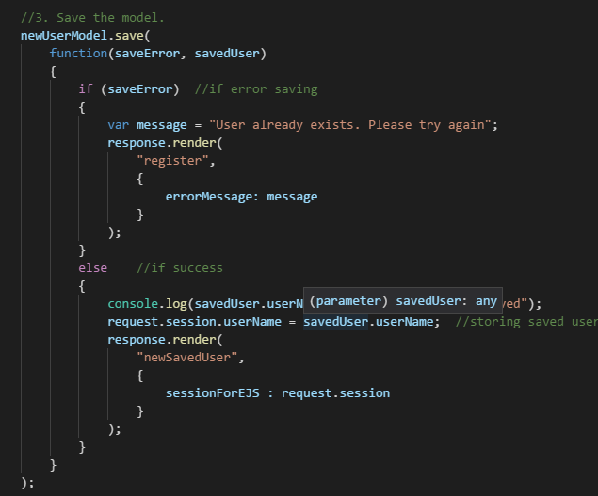
Phase 3
Function | Route phase | Current Operation | Needed Operation
Signup | /newUser | Storing in session Check if user already in session’s username. If so, user already exists error, Render /register with errorMessage If not, store it as session’s user name. Render /newSavedUser (pass on session details) | Store in DB Create new mongoose model with given credentials Save the model (writes to DB) If error returned, “user already exists”, Render /register with errorMessage If no error, store returned username as session’s user name. Render /newSavedUser (pass on session details)

Slide 18
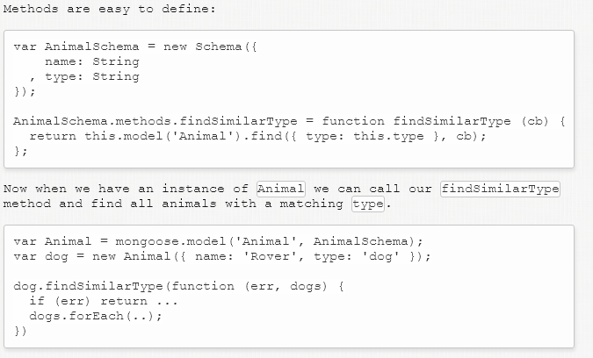
Phase 3
Search in DB for matching
userName
Model.findOne( {userName} )
Function | Route phase | Current Operation | Needed Operation
Login | /authenticate | Logging in session Check if user credential’s match with current session If so, render /newStory (pass on session details) Session.loggedIn = true If not, render /login with errorMessage | Logging using DB Check if username is in the DB If null returned, render /login with errorMessage (user does not exist). Exit function. If not null, check if password matches in DB. If so, render /newStory (pass on session details) Session.loggedIn = true If not, render /login with errorMessage (pw does not match) (Not a good practise to explicitly say which is not matching, but this is for dev purpose)
Model returns a
User object (user’s mail, pw)
Object.compare(password)
Entered login pw passed
For comparision
Learn Mongoose methods in short here to proceed:
http://mongoosejs.com/docs/2.7.x/docs/methods-statics.html
Note:
As password is still plain, we could have compared in find method itself to filter
For both username and password, but we are using “mongoose methods”
So as to use bcrypt functionality later..
This way we can confine bcrypt to db.js itself. Also helps you to learn to use mongoose methods

Slide 19
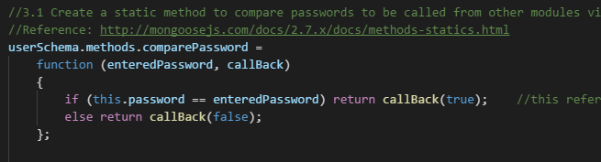
Phase 3
Search in DB for matching
userName
Model.findOne( {userName} )
Mongoose method definition in db.js (Note the “=“, I missed that for long time and breaking my head debugging
Model returns a
User object (user’s mail, pw)
Object.compare(password)
Entered login pw passed
For comparision
Mongoose method defintion
userSchema.methods.compare = function(enteredPassword, callBack)
{
if (this.password == enteredPassword) return callBack(false);
else return callBack(true);
}
Note how callback is called in return!

Slide 20
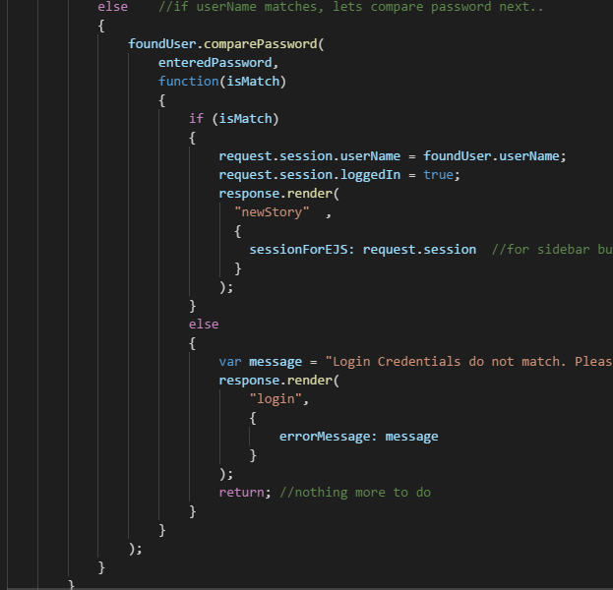
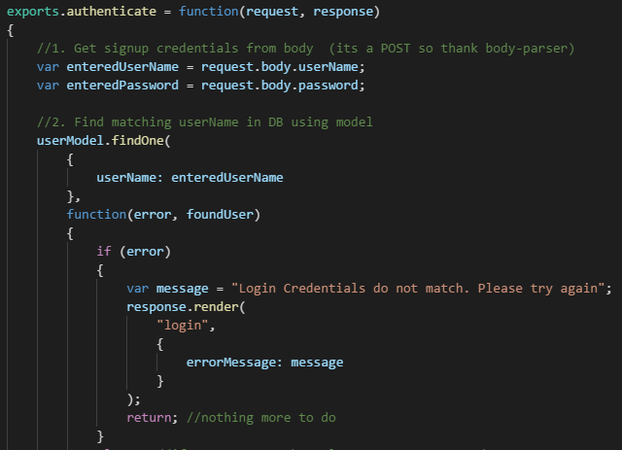
Phase 3
username and password verification – read carefully and understand

Slide 21
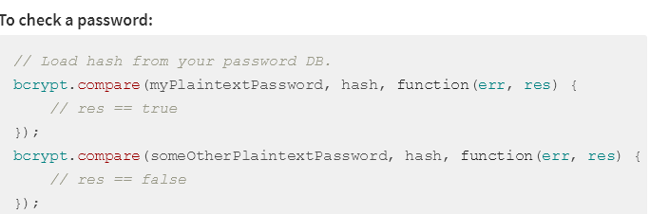
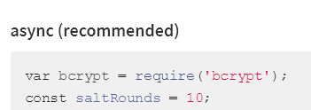
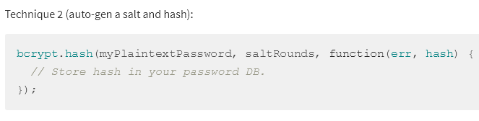
Phase 3
Note that, since we used mongoose method, we need to use bcrypt only in db.js
As both generation and comparision is done there only
Step 2:
Let us hash the password using bcrypt before saving (so will use pre hook from mongoose)
Since its hashed, we need to use bcrypt’s compare method to know if password matches.
This goes in the mongoose method we defined for comparing password
Since bcrypt has installation issues at the time of this tutorial, we will use bcrypt.js which is same but written in JS. All the coding is same except during installation and require
Use bcryptjs instead of bcrypt. Bcryptjs is too slow so for production, consider bcrypt
Ref:https://www.npmjs.com/package/bcrypt
Ref:https://www.npmjs.com/package/bcryptjs
3
1
2
This goes in “pre” hook of “save” of mongoose model. That is,we hash the
password, before saving it in DB

Slide 22
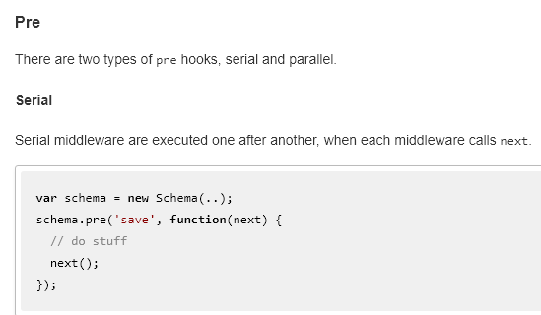
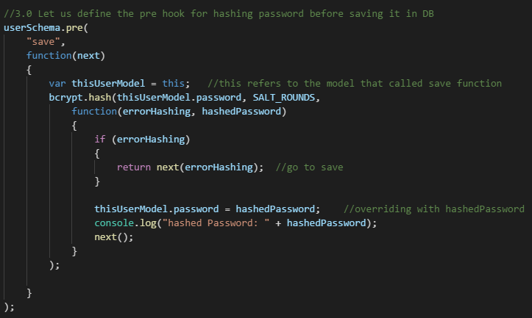
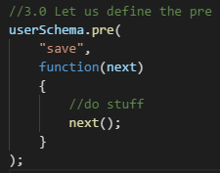

Phase 3
We will use serial pre hook of mongoose for this purpose.
Recall, that save is called by userModel instance in route.js. So in this pre hook, “this” would refer to that model instance. This is how, we could get the password to be hashed here.
2
1
Also Note, when there is an error, we are sending next(error)

Slide 23
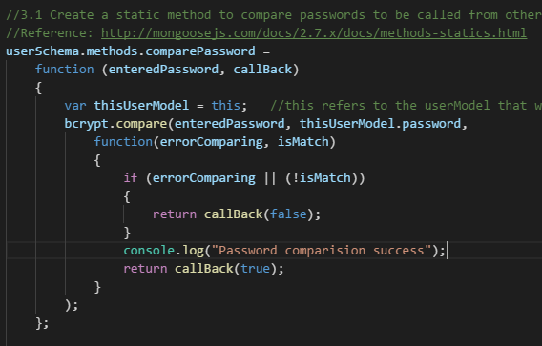
Phase 3
And then the compare password method..
3

Slide 24
Phase 4
newStory.html
Pageless
allStories.html
slugStory.html
Save in DB
If error, 500
Show title and link
For all user stories
Here.
Show the chosen
Story
Fully
here
User creates the story
Story Mgmt
/addStory
/allStories
/slugStory
User Mgmt
POST
GET
GET
Templates
1
2
3
Mongoose
MongoDB
(local)
We shall store only following in DB for simplicity.
Author
Title (unique)
Content
Slug (generated from title)

Slide 25

Phase 4
1.1
newStory.html
Pageless
Mongoose “Special” Modularization – you need not export models!
Ref: https://stackoverflow.com/questions/38274979/how-to-use-a-mongoose-model-defined-in-a-separate-file-if-the-file-is-not-export
Save in DB
If error, 500(later)
User creates the story
/addStory
Loaded first to do DB connection
POST
1
app.js
Load to create models. Note: Don’t export
Mongoose
1.1. Modularize DB.js (separate userModel export)
1.2. In storyDB.js,
Create storySchema, storyModel
1.3.Use storyModel, to save story in DB
Load routes where models would be used

Slide 26
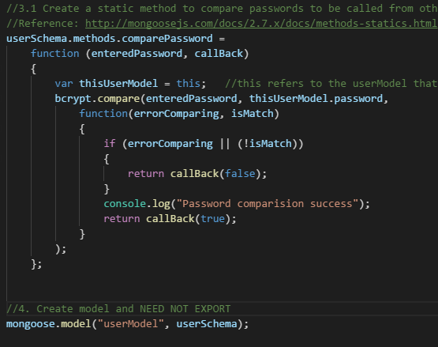
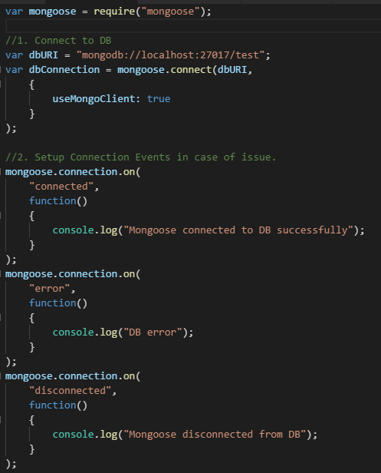
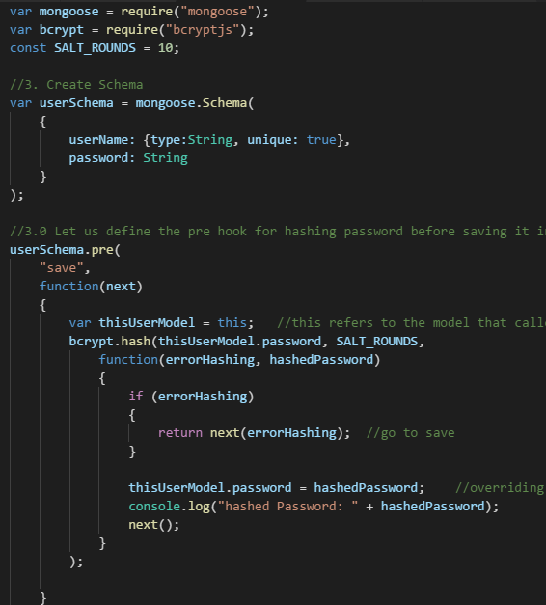

Phase 4
1.1
1.1
DB Connection (just retaind only connection part
from previous Phase SW)
Model creation ready to be used in other modules without having to export
See, no export!
1.1
Route.js directly accessing model via mongoose

Slide 27
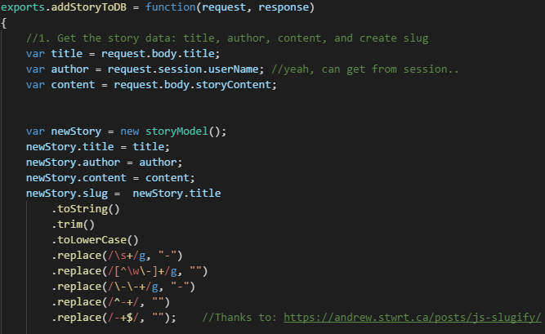
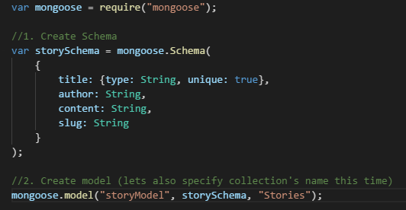
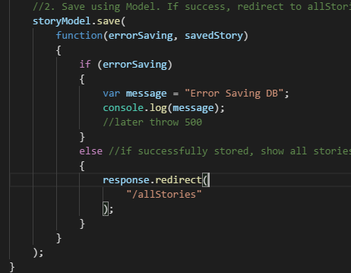


Phase 4
1.2
In storyDB.js,
Create storySchema, storyModel
Loading in app.js to register schema
Serious Internal error but lets
Throw 500 later
And then using in route.js
Why not render instead of
Redirecting? This may answer?
https://en.wikipedia.org/wiki/Post/Redirect/Get

Slide 28
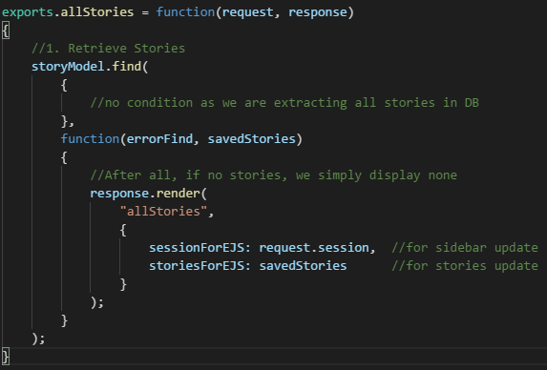
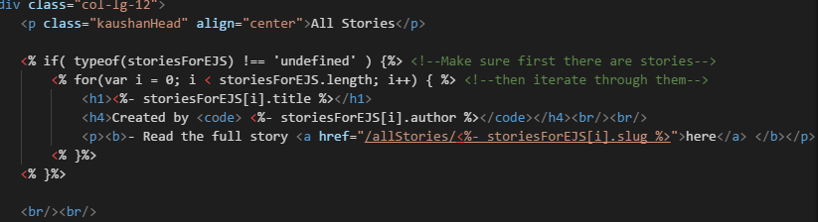
Phase 4
2.1
allStories.html
Changes Overview:
2.1 Route.js (to retrieve stories)
2.2 AllStories.EJS (to display stories)
Show title and link
For all user stories
Here.
/allStories
/slugStory
GET
GET
2
Mongoose
2.2
All Stories may come from different paths
After creatingnew Story, routed to All Stories
A guest (not logged in), could directly access All Stories
User can now access individual stories from here so next, we will create story page for them..

Slide 29
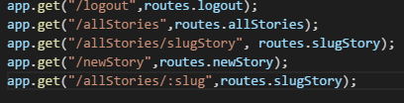
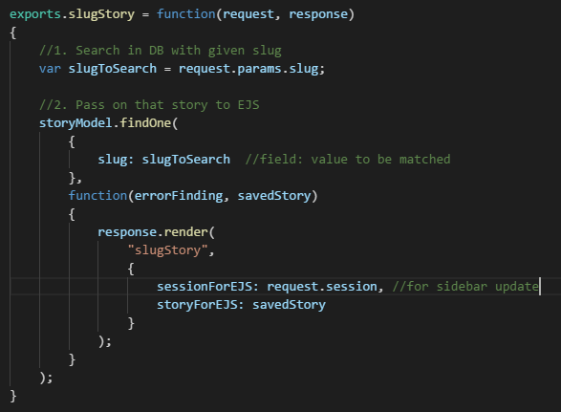
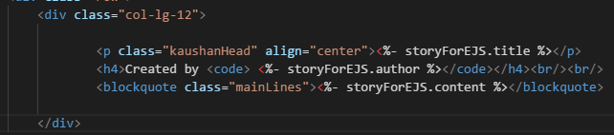
Phase 4
3.1
slugStory.html
Show the chosen
Story
Fully
here
Change Overview
3.1 In App.js define route for /allStories/:slug to slugStory.EJS
3.2 In route.js, using storyModel, findOne(), get the story
Which matches the slug. Pass on foundStory that to slugStory.EJS via render method
3.3. If foundStory is not undefined, display the title and contents in slugStory.EJS
/slugStory
3.2
GET
3
Mongoose
3.3
Validation if storyForEJS undefined is not required caz, we would
Not be in this page without an existing story in first place

Slide 30
Phase 5
Summary:
5.1. We could use logout page template for 404 & 500. Why?
We want to avoid any further error that might arise from log check in sidebar.ejs.
5.2. During normal routing, we just render. But this error handling, we
Need to inform client, the http status (which otherwise receive 200 for normal). So we set the status and send as follows
Response.status(404).render(“404”); in app.js
Response.status(500).render(“500”) in app.js & error location
5.3. These routing in app.js should be placed as last of all routing.
5.4. For now for demo,
DB error for saving story : 500
DB connection: chalk
5.5. MongoDB using online cloud service. And then Heroku deployment.
Story Mgmt
Others*
User Mgmt
Templates
MongoDB
(Cloud)
Error Mgmt (404, 500,Chalk)
Add comments shall be postponed as an exercise
(actually not feeling well while doing this, so want to wrap up)

Slide 31
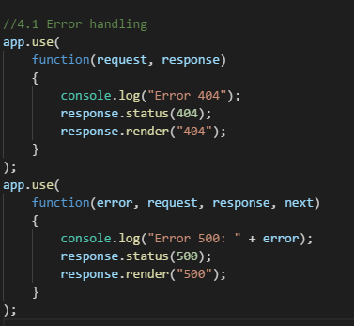
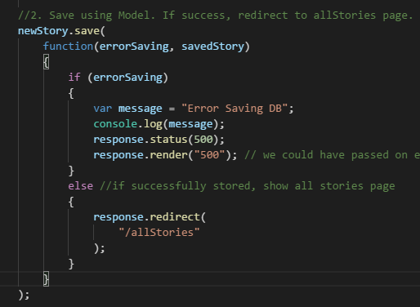
Phase 5
Summary:
5.1. We could use logout page template for 404 & 500. Why?
We want to avoid any further error that might arise from log check in sidebar.ejs.
5.2. During normal routing, we just render. But this error handling, we
Need to inform client, the http status (which otherwise receive 200 for normal). So we set the status and send as follows
Response.status(404).render(“404”); in app.js
Response.status(500).render(“500”) in app.js & error location
5.3. These routing in app.js should be placed as last of all routing.
5.4. For now for demo,
DB error for saving story : 500
DB connection: chalk
App.js
Route.js
Note: As per tutorial we have to send(500)
Instead of render() as above which atm
Raised as a query. Awaiting edureka’s reply

Slide 32
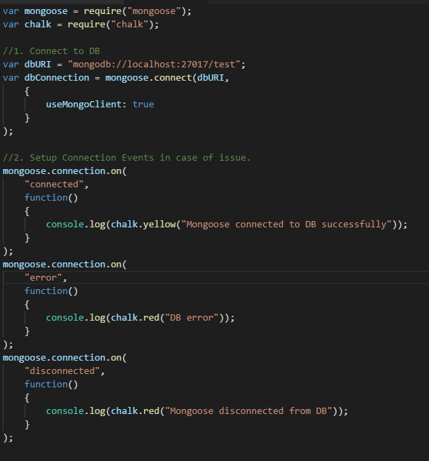
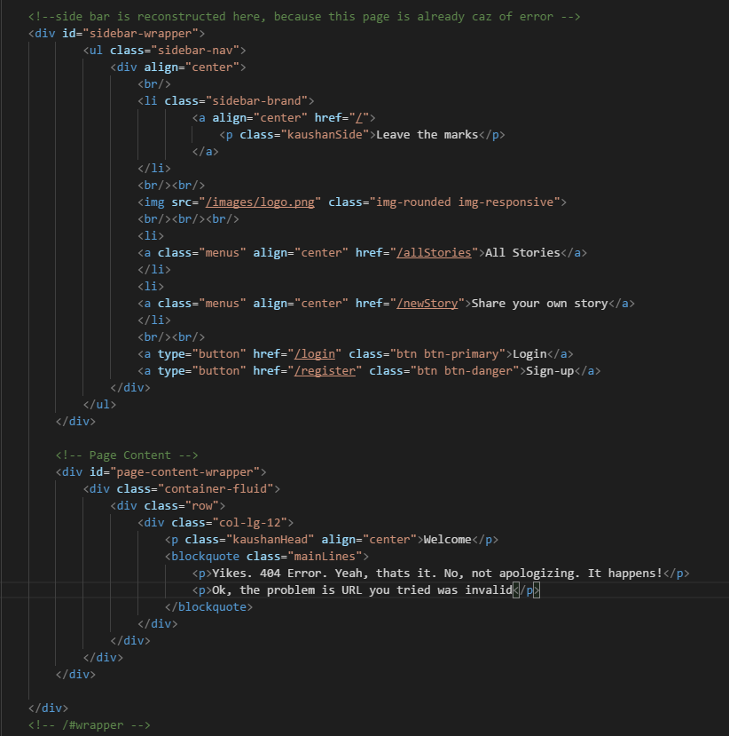

Phase 5
Using chalk in db.js (very straight forward)
404.Ejs (and similarly for 500.ejs)

